Slide 1


Shailendra Kumar
4/30/2023

Slide 2

Outline
Executive Summary
Introduction
Methodology
Results
Conclusion
Appendix

Slide 3
Executive Summary
Summary of methodologies
Data collection, Data Wrangling, Data Analysis, Data Visualization, Dashboards and Predictive Analytics
Summary of all results
Predict with accuracy of 83%
Generated Dashboard to find insights visually

Slide 4
Introduction
Project background and context
We predicted if the Falcon 9 first stage will land successfully. SpaceX advertises Falcon 9 rocket launches on its website, with a cost of 62 million dollars; other providers cost upward of 165 million dollars each, much of the savings is because SpaceX can reuse the first stage. Therefore if we can determine if the first stage will land, we can determine the cost of a launch. This information can be used if an alternate company wants to bid against SpaceX for a rocket launch. I
Problems you want to find answers
We wanted to determine the price of each launch. We did this by gathering information about Space X and creating dashboards. We also determined if SpaceX will reuse the first stage. We trained a machine learning model and used public information to predict if SpaceX will reuse the first stage.

Slide 5

Section 1

Slide 6
Methodology
Executive Summary
Data collection methodology:
Collected Falcon 9 historical launch records from a Wikipedia page titled List of Falcon 9 and Falcon Heavy launches updated on 9th June 2021
Perform data wrangling
Perform exploratory data analysis (EDA) using visualization and SQL
Perform interactive visual analytics using Folium and Plotly Dash
Perform predictive analysis using classification models

Slide 7
Data Collection
We web scraped to collect Falcon 9 historical launch records from a Wikipedia page titled List of Falcon 9 and Falcon Heavy launches updated on 9th June 2021
https://en.wikipedia.org/wiki/List_of_Falcon_9_and_Falcon_Heavy_launches
Web scraping done for Falcon 9 launch records with BeautifulSoup
Extracted a Falcon 9 launch records HTML table from Wikipedia
Parsed the table and converted it into a Pandas data frame
Requested the Falcon9 Launch Wiki page from its URL
Extracted all column/variable names from the HTML table header
Created a data frame by parsing the launch HTML tables

Slide 8
Data Collection – SpaceX API
Flowchart:
Made Request to the SpaceX API
Cleaned the requested data
Requested and parsed the SpaceX launch data using the GET request
Filtered the dataframe to only include Falcon 9 launches
Data Wrangling done
Dealt with Missing Values
GitHub URL
https://github.com/shail-70/AppliedDataScienceCapstone/blob/02b15a862e53aada7a0234a5553b6f83786cd0cf/jupyter-labs-spacex-data-collection-api.ipynb

Slide 9
Data Collection - Scraping
GitHub URL
https://github.com/shail-70/AppliedDataScienceCapstone/blob/02b15a862e53aada7a0234a5553b6f83786cd0cf/jupyter-labs-webscraping%20(1).ipynb
Flowchart:
Web scrap Falcon 9 launch records with BeautifulSoup:
Extract a Falcon 9 launch records HTML table from Wikipedia
Parse the table and convert it into a Pandas data frame
Request the Falcon9 Launch Wiki page from its URL
Extract all column/variable names from the HTML table header
Create a data frame by parsing the launch HTML tables

Slide 10
Data Wrangling
We performed some Exploratory Data Analysis (EDA) to find some patterns in the data and determine what would be the label for training supervised models.
Flowchart:
Performed exploratory Data Analysis and determine Training Labels
Exploratory Data Analysis
Calculated the number of launches on each site
Calculated the number and occurrence of each orbit
Calculated the number and occurence of mission outcome per orbit type
Determine Training Labels
Create a landing outcome label from Outcome column
GitHub URL:
https://github.com/shail-70/AppliedDataScienceCapstone/blob/02b15a862e53aada7a0234a5553b6f83786cd0cf/IBM-DS0321EN-SkillsNetwork_labs_module_1_L3_labs-jupyter-spacex-data_wrangling_jupyterlite.jupyterlite.ipynb

Slide 11
EDA with Data Visualization
Summary of charts plotted
plot out the FlightNumber vs. PayloadMass - Categorical Plot(Catplot)
Visualize the relationship between Flight Number and Launch Site (catplot)
Visualize the relationship between Payload and Launch Site (catplot)
Visualize the relationship between success rate of each orbit type (barplot)
Visualize the relationship between FlightNumber and Orbit type (Catplot)
Visualize the relationship between Payload and Orbit type (Catplot)
Visualize the launch success yearly trend (lineplot)
Github URL:
https://github.com/shail-70/AppliedDataScienceCapstone/blob/02b15a862e53aada7a0234a5553b6f83786cd0cf/IBM-DS0321EN-SkillsNetwork_labs_module_2_jupyter-labs-eda-dataviz.ipynb.jupyterlite.ipynb

Slide 12
EDA with SQL
Summary of the SQL queries performed to understand the Spacex DataSet
Loaded the dataset into the corresponding table in a Db2 database
Displayed the names of the unique launch sites in the space mission
Displayed 5 records where launch sites begin with the string 'CCA’
Displayed the total payload mass carried by boosters launched by NASA (CRS)
Displayed average payload mass carried by booster version F9 v1.1
Listed the date when the first succesful landing outcome in ground pad was acheived.
Listed the names of the boosters which have success in drone ship and have payload mass greater than 4000 but less than 6000
Listed the total number of successful and failure mission outcomes
Listed the names of the booster_versions which have carried the maximum payload mass.
Listed the records which will display the month names, failure landing_outcomes in drone ship ,booster versions, launch_site
Ranked the count of successful landing_outcomes
GitHub URL:
https://github.com/shail-70/AppliedDataScienceCapstone/blob/02b15a862e53aada7a0234a5553b6f83786cd0cf/jupyter-labs-eda-sql-coursera_sqllite.ipynb

Slide 13
Build an Interactive Map with Folium
Summary of map objects created and added to a folium map
Folium Circle to add a highlighted circle area with a text label on a specific coordinate
Folium.Marker for each launch site on the site map
Marker clusters to simplify a map containing many markers having the same coordinate.
MousePosition on the map to get coordinate for a mouse over a point on the map
Draw a PolyLine between a launch site to the selected coastline point
We added those objects to
Mark all launch sites on a map
Mark the success/failed launches for each site on the map
Calculate the distances between a launch site to its proximities
GitHub URL:
https://github.com/shail-70/AppliedDataScienceCapstone/blob/2fdb82234f35b369dee928c4953a476f019bfadb/IBM-DS0321EN-SkillsNetwork_labs_module_3_lab_jupyter_launch_site_location.jupyterlite.ipynb

Slide 14
Build a Dashboard with Plotly Dash
Summary of plots/graphs and interactions we have added to dashboard
Added a Launch Site Drop-down Input Component
Added a callback function to render success-pie-chart based on selected site dropdown
Add a Range Slider to Select Payload
Add a callback function to render the success-payload-scatter-chart scatter plot
We added those plots and interactions to:
Build a Plotly Dash application for users to perform interactive visual analytics on SpaceX launch data in real-time.
GitHub: https://github.com/shail-70/AppliedDataScienceCapstone/blob/4e4ad5b5a68b2f5b38626edad3e9d90025f19146/spacex_dash_app.py

Slide 15
Predictive Analysis (Classification)
Summary of how we built, evaluated, improved, and found the best performing classification model
Performed exploratory Data Analysis and determined Training Labels
created a column for the class
Standardized the data
Split into training data and test data
-Found best Hyperparameter for SVM, Classification Trees and Logistic Regression
Found the method performs best using test data
You need present your model development process using key phrases and flowchart
Loaded the dataframe
Created a NumPy array from the column Class
Standardized the data
split the data X and Y into training and test data
Created logistic regression, support vector machine , decision tree classifier, k nearest neighbors models then create a GridSearchCV object
Calculated the accuracy on the test data
Found the method performs best
GitHub URL:
https://github.com/shail-70/AppliedDataScienceCapstone/blob/199310dc9a3e0bc4f5721dc95bc520ea13cda176/IBM-DS0321EN-SkillsNetwork_labs_module_4_SpaceX_Machine_Learning_Prediction_Part_5.jupyterlite.ipynb

Slide 16
Results
Exploratory data analysis results
Interactive analytics demo in screenshots
Predictive analysis results

Slide 17

Section 2

Slide 18
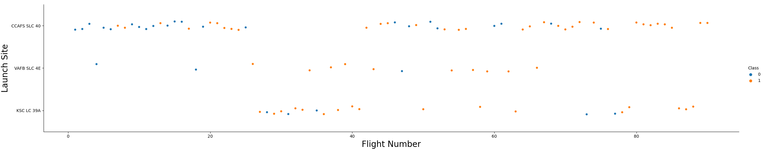
Flight Number vs. Launch Site
Different launch sites have different success rates. CCAFS LC-40, has a success rate of 60 %, while KSC LC-39A and VAFB SLC 4E has a success rate of 77%.

Slide 19
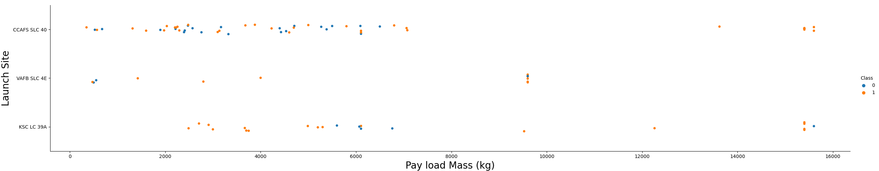
Payload vs. Launch Site
VAFB-SLC launchsite there are no rockets launched for heavypayload mass(greater than 10000)

Slide 20
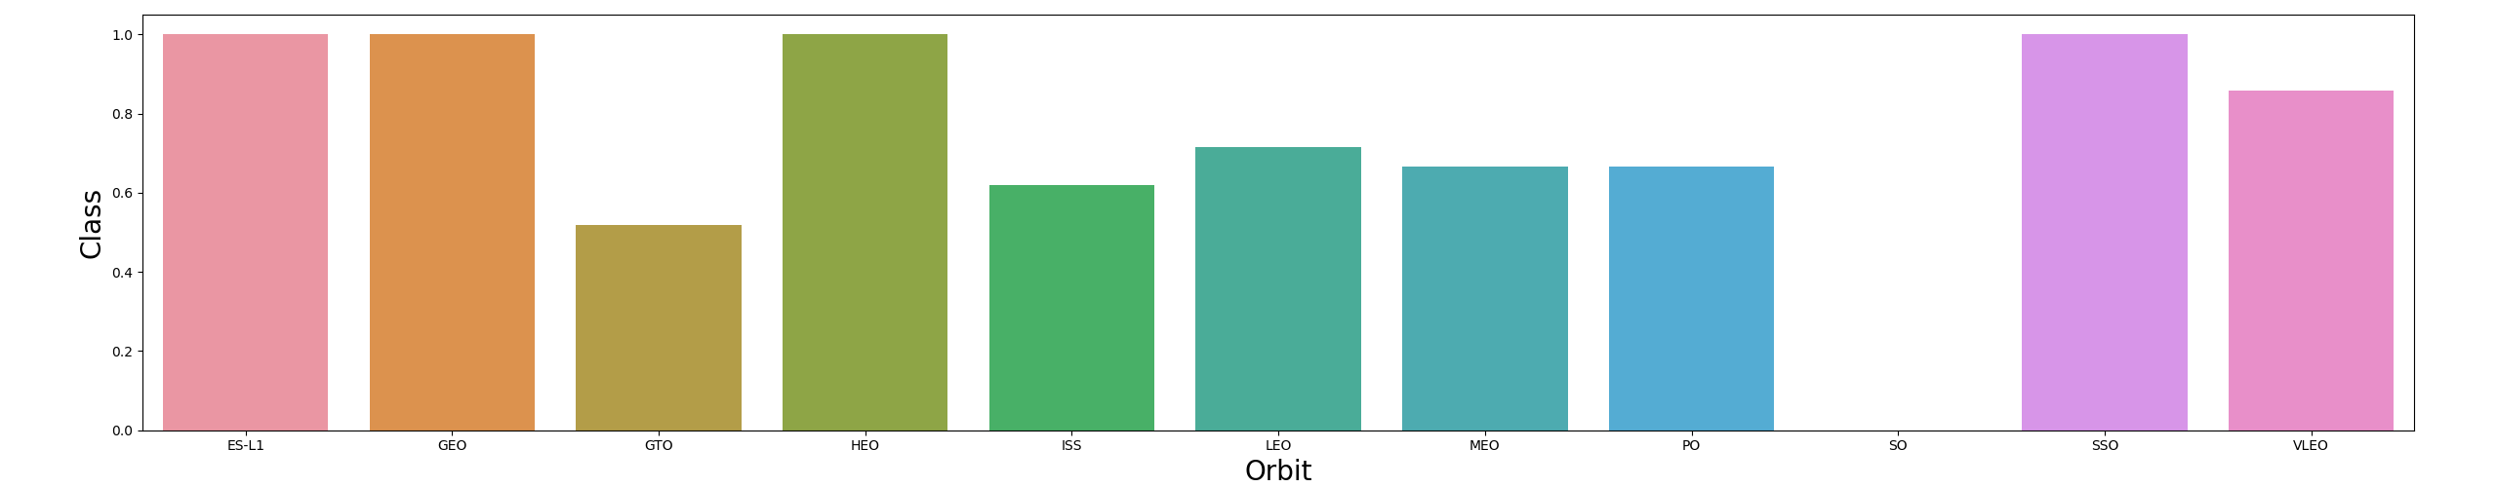
Success Rate vs. Orbit Type
Visualise relationship between success rate and orbit type

Slide 21
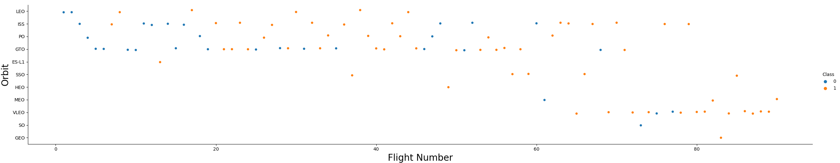
Flight Number vs. Orbit Type
LEO orbit the Success appears related to the number of flights; on the other hand, there seems to be no relationship between flight number when in GTO orbit.

Slide 22
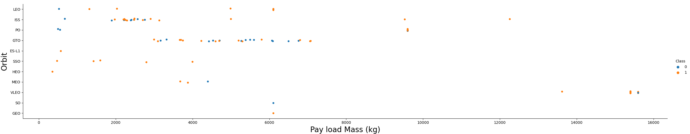
Payload vs. Orbit Type
With heavy payloads the successful landing or positive landing rate are more for Polar,LEO and ISS.
However for GTO we cannot distinguish this well as both positive landing rate and negative landing(unsuccessful mission) are both there here.

Slide 23
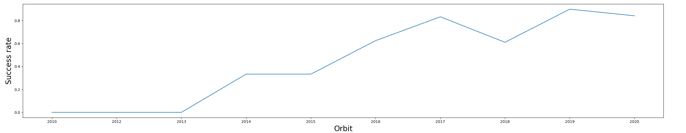
Launch Success Yearly Trend
sucess rate since 2013 kept increasing till 2020

Slide 24
All Launch Site Names
Find the names of the unique launch sites
'CCAFS LC-40', 'VAFB SLC-4E', 'KSC LC-39A', 'CCAFS SLC-40'

Slide 25
Launch Site Names Begin with 'CCA'
Find 5 records where launch sites begin with `CCA`
The launch site name of the 5 records is CCAFS LC-40

Slide 26
Total Payload Mass
Calculate the total payload carried by boosters from NASA
45596 Kg

Slide 27
Average Payload Mass by F9 v1.1
Calculate the average payload mass carried by booster version F9 v1.1
2928.4 Kg

Slide 28
First Successful Ground Landing Date
Find the dates of the first successful landing outcome on ground pad
22nd December 2015

Slide 29
Successful Drone Ship Landing with Payload between 4000 and 6000
List the names of boosters which have successfully landed on drone ship and had payload mass greater than 4000 but less than 6000
'F9 FT B1022','F9 FT B1026','F9 FT B1021.2','F9 FT B1031.2'

Slide 30
Total Number of Successful and Failure Mission Outcomes
Calculate the total number of successful and failure mission outcomes
100 Successful
1 Failure

Slide 31
Boosters Carried Maximum Payload
List the names of the booster which have carried the maximum payload mass
'F9 B5 B1048.4'
'F9 B5 B1049.4'
'F9 B5 B1051.3'
'F9 B5 B1056.4'
'F9 B5 B1048.5'
'F9 B5 B1051.4'
'F9 B5 B1049.5'
'F9 B5 B1060.2 '
'F9 B5 B1058.3 '
'F9 B5 B1051.6'
'F9 B5 B1060.3'
'F9 B5 B1049.7 '

Slide 32
2015 Launch Records
List the failed landing_outcomes in drone ship, their booster versions, and launch site names for in year 2015
'Jan', '2015', 'Failure (drone ship)', 'F9 v1.1 B1012', 'CCAFS LC-40'
'Apr', '2015', 'Failure (drone ship)', 'F9 v1.1 B1015', 'CCAFS LC-40'
'Jun', '2015', 'Precluded (drone ship)', 'F9 v1.1 B1018', 'CCAFS LC-40'

Slide 33
Rank Landing Outcomes Between 2010-06-04 and 2017-03-20
Rank the count of landing outcomes (such as Failure (drone ship) or Success (ground pad)) between the date 2010-06-04 and 2017-03-20, in descending order
'19-02-2017'
'14-01-2017'
'14-08-2016'
'18-07-2016'
'27-05-2016'
'06-05-2016'
'08-04-2016'
'22-12-2015'

Slide 34

Section 3

Slide 35

The generated map with marked launch sites
Replace <Folium map screenshot 1> title with an appropriate title
Explore the generated folium map and make a proper screenshot to include all launch sites’ location markers on a global map
Explain the important elements and findings on the screenshot

Slide 36
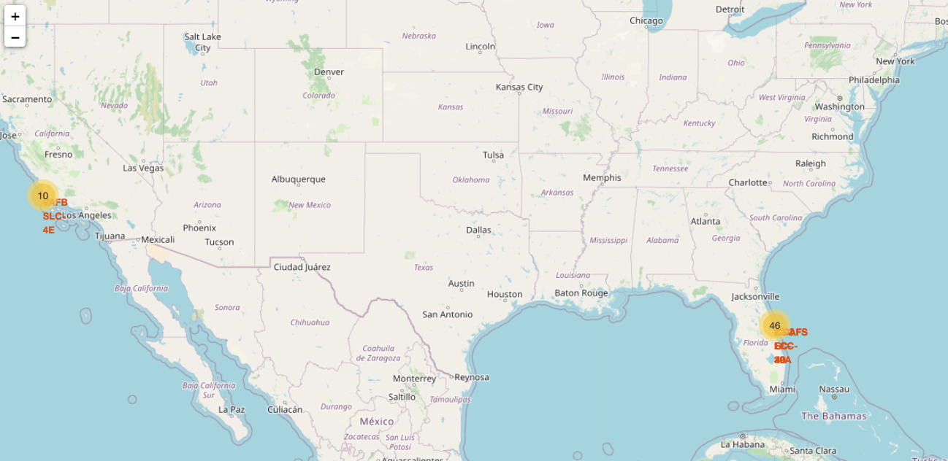
Mark the success/failed launches for each site on the map
Replace <Folium map screenshot 2> title with an appropriate title
Explore the folium map and make a proper screenshot to show the color-labeled launch outcomes on the map
Explain the important elements and findings on the screenshot

Slide 37

Selected launch site to its proximities such as railway, highway, coastline, with distance calculated and displayed
Replace <Folium map screenshot 3> title with an appropriate title
Explore the generated folium map and show the screenshot of a selected launch site to its proximities such as railway, highway, coastline, with distance calculated and displayed
Explain the important elements and findings on the screenshot

Slide 38

Section 4

Slide 39
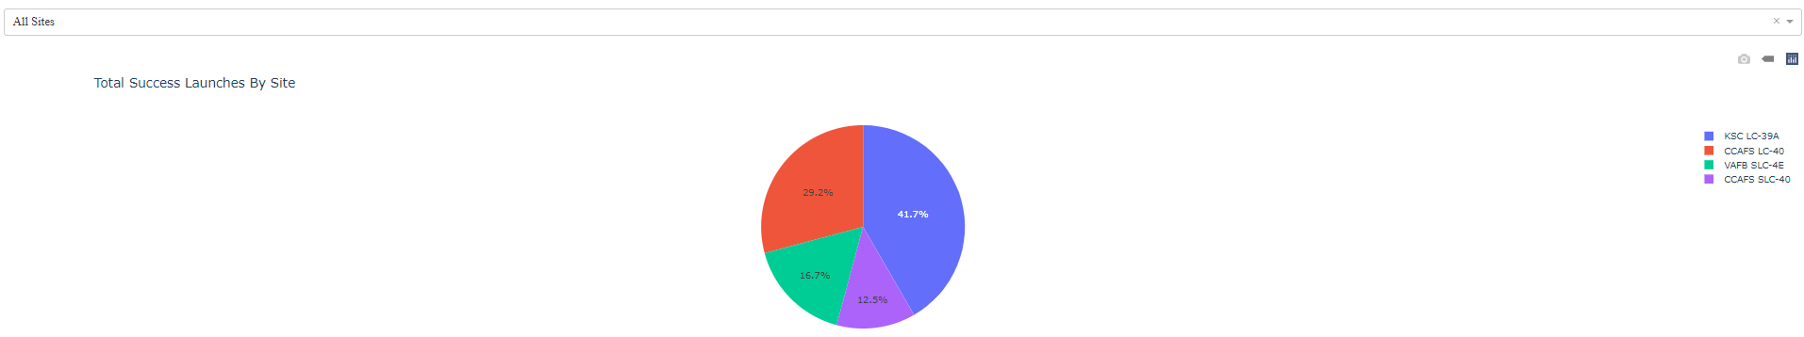
Launch success count for all sites
Explain the important elements and findings on the screenshot

Slide 40
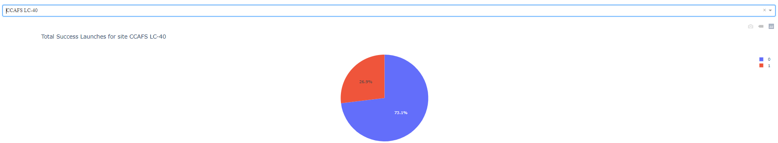
Total Success Launches
Replace <Dashboard screenshot 2> title with an appropriate title
Show the screenshot of the piechart for the launch site with highest launch success ratio
Explain the important elements and findings on the screenshot

Slide 41
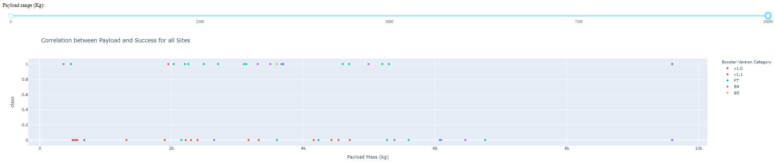
Correlation between Palyload and Succuss
Replace <Dashboard screenshot 3> title with an appropriate title
Show screenshots of Payload vs. Launch Outcome scatter plot for all sites, with different payload selected in the range slider
Explain the important elements and findings on the screenshot, such as which payload range or booster version have the largest success rate, etc.

Slide 42

Section 5

Slide 43
Classification Accuracy
Visualize the built model accuracy for all built classification models, in a bar chart
Find which model has the highest classification accuracy
Tree model had highest training accuracy and similar test accuracy

Slide 44
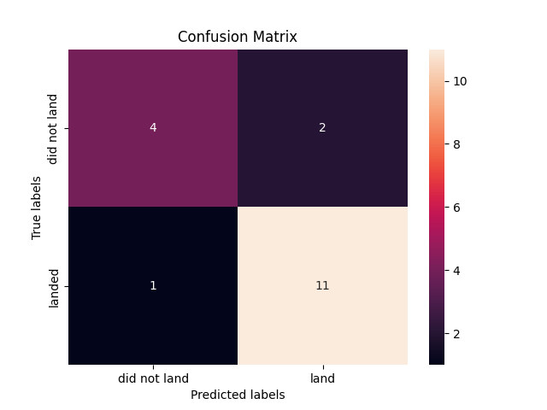
Confusion Matrix
confusion matrix of the best performing model (tree model). It had best training accuracy and similar test accuracy

Slide 45
Conclusions
Different launch sites have different success rates. CCAFS LC-40, has a success rate of 60 %, while KSC LC-39A and VAFB SLC 4E has a success rate of 77%.
VAFB-SLC launchsite there are no rockets launched for heavypayload mass(greater than 10000)
Success rate since 2013 kept increasing till 2020
The first successful landing outcome on ground pad was on 22nd December 2015
Generated Dashboard to analyze data visually
Accuracy of predictive model is 83%

Slide 46
Appendix
Include any relevant assets like Python code snippets, SQL queries, charts, Notebook outputs, or data sets that you may have created during this project

Slide 47


